Slide 1
Prediction of cryptocurrency prices using LSTM and cryptocurrency financial data
CSE 6363-001 Machine Learning Spring 2018
Kaustubh Agnihotri
1001554290

Slide 2
Overview
Introduction
Dataset Description
Methods used
Results
Conclusion
References

Slide 3
Introduction
What is cryptocurrency?
Why this topic?
How AI can help?
Database source
Models used

Slide 4
Dataset Description
The data is pulled from following link:
https://coinmarketcap.com/
The project has been implemented for the following 5 currencies and can be extended for any other:
Bitcoin
Ethereum
Ripple
Bitcoin cash
Litecoin
This ensures that we always have the latest market data

Slide 5
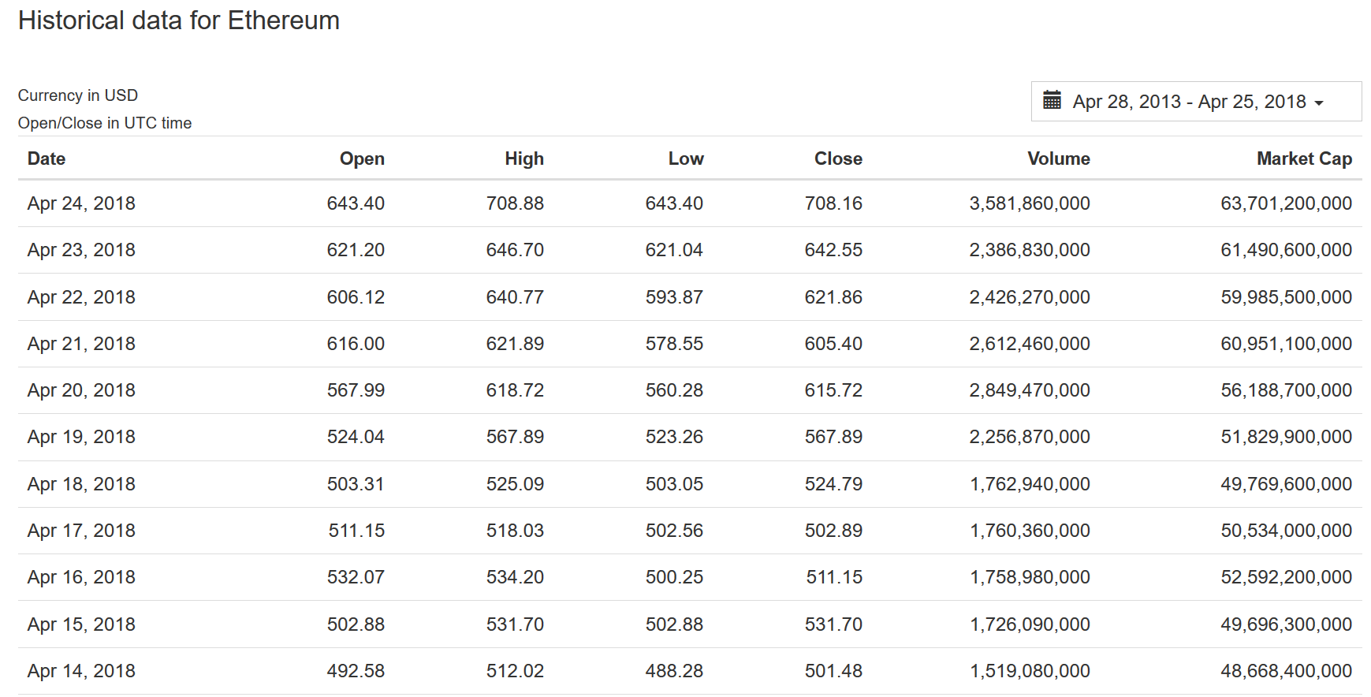
Dataset Description

Slide 6
Dataset Description
For this presentation the Ethereum data is used for all the implementations
Let us visualize the data and then divide it into train and test partitions

Slide 7
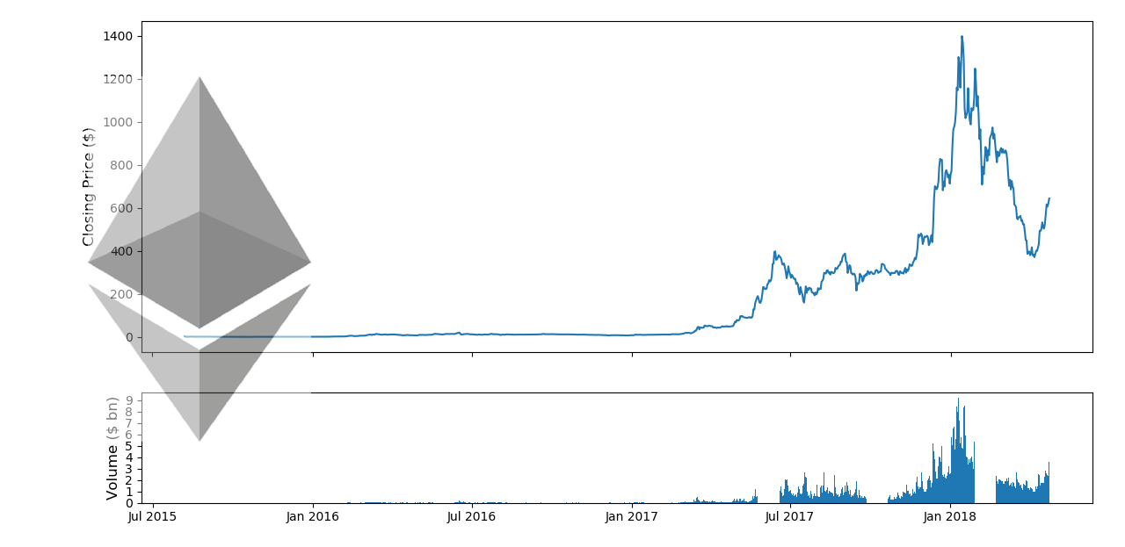
Dataset Description: Gathered Ethereum data

Slide 8
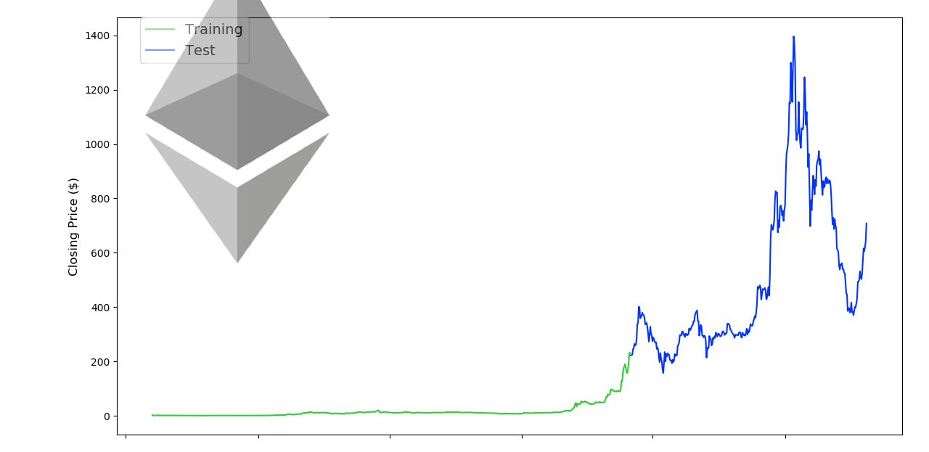
Dataset Description: Train and test data division

Slide 9
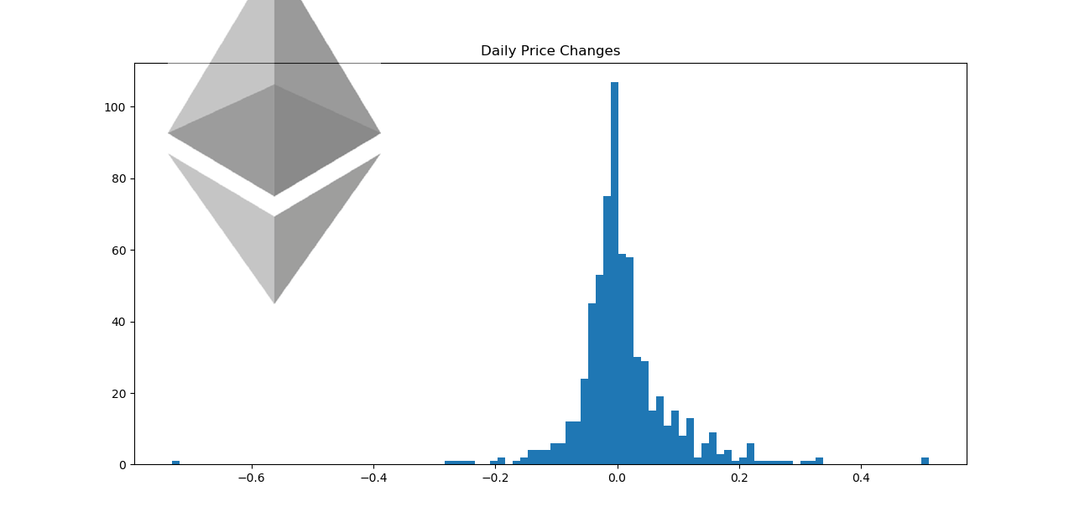
Dataset Description: Normal distribution of data

Slide 10
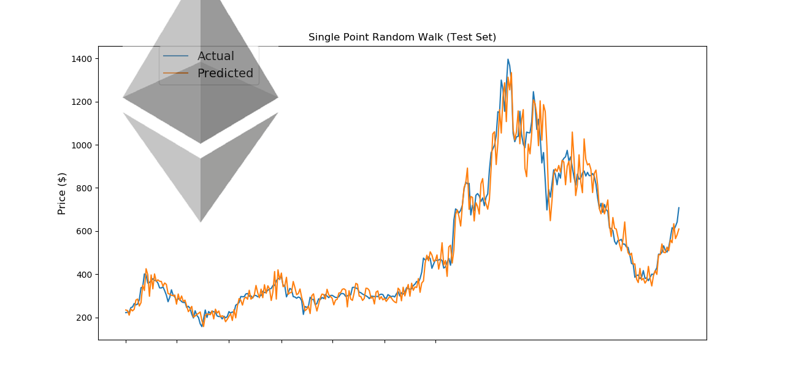
Dataset Description: Single point random walk

Slide 11
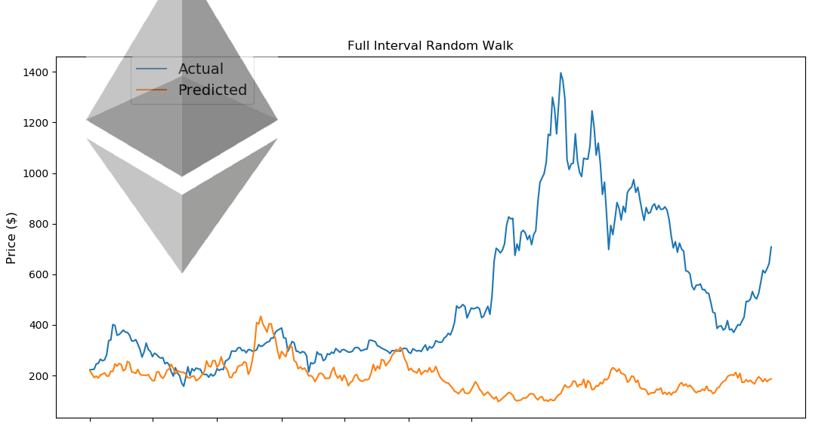
Dataset Description: Full interval random walk

Slide 12
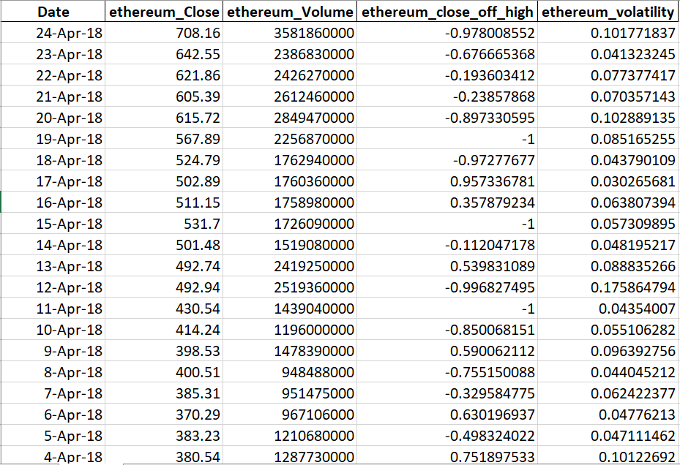
Dataset Description: Feature extraction

Slide 13
Methods Used
The following methods have been used for predicting the prices and a comparison is done amongst them to determine the better performing method:
LSTM (Long Short Term Memory)
MLP (Multi Layer Perceptron)
Random walk

Slide 14
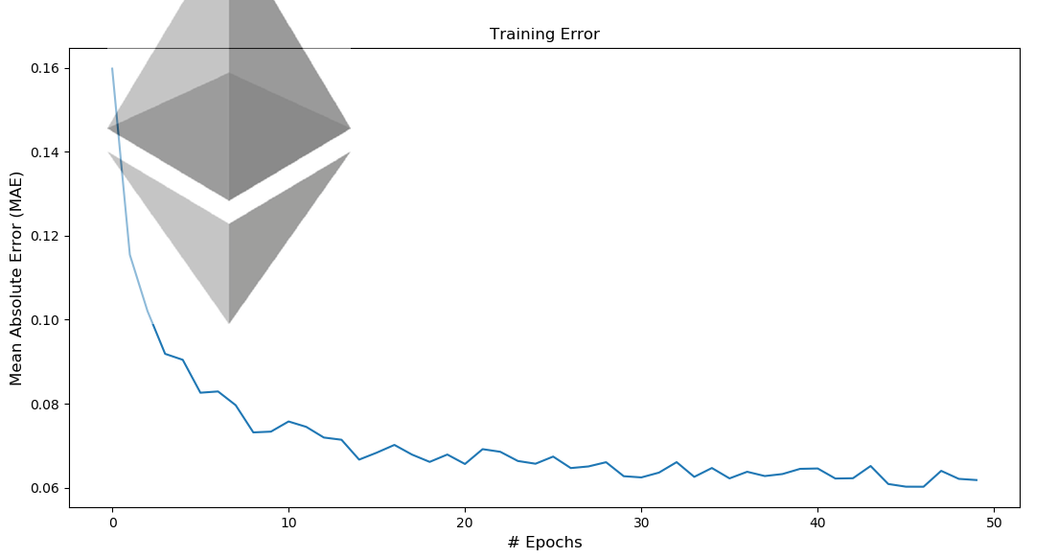
LSTM: Mean absolute error

Slide 15
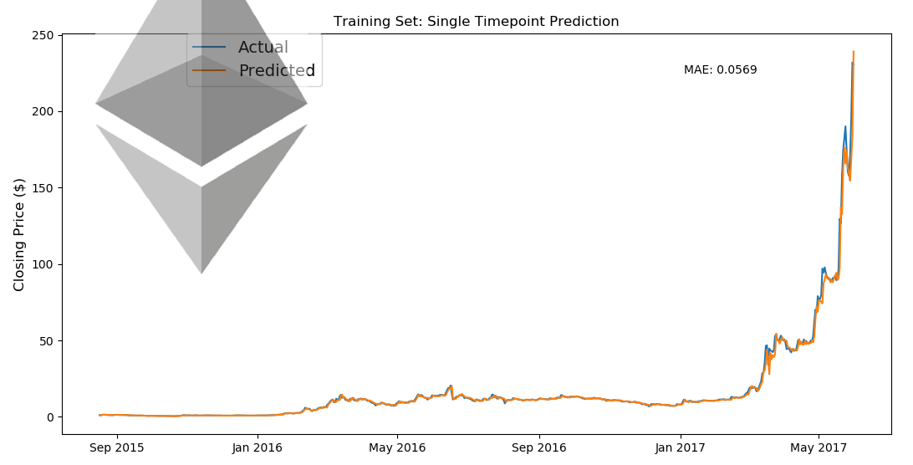
LSTM: Training set prediction

Slide 16
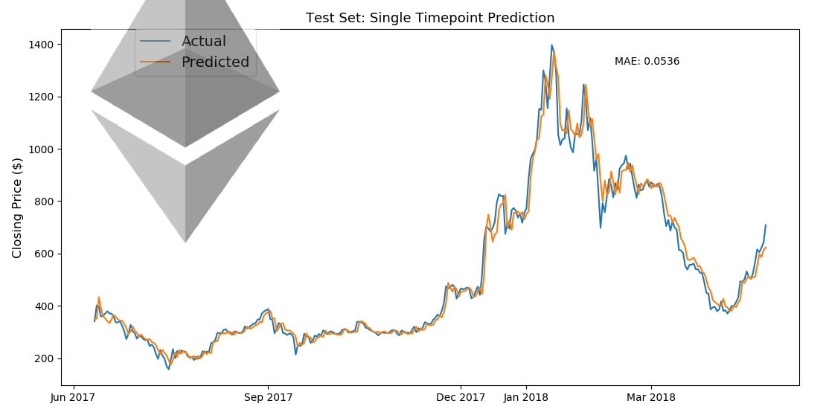
Results: Test set prediction

Slide 17
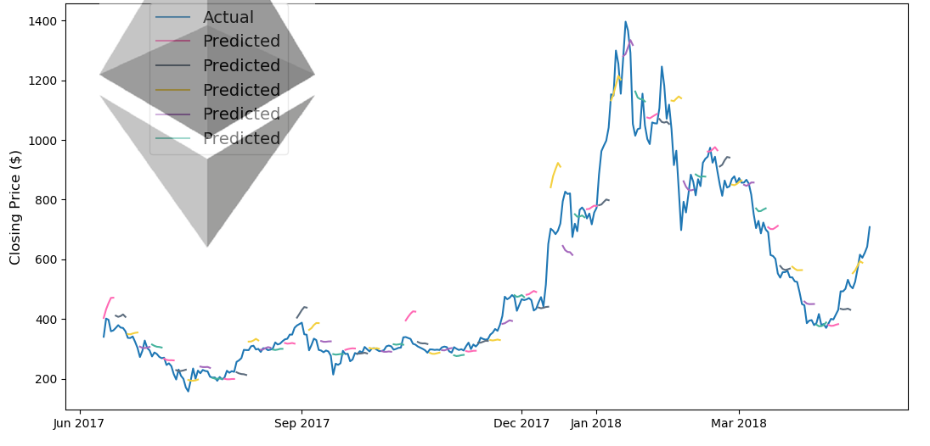
Results: Test set prediction for 5 days

Slide 18
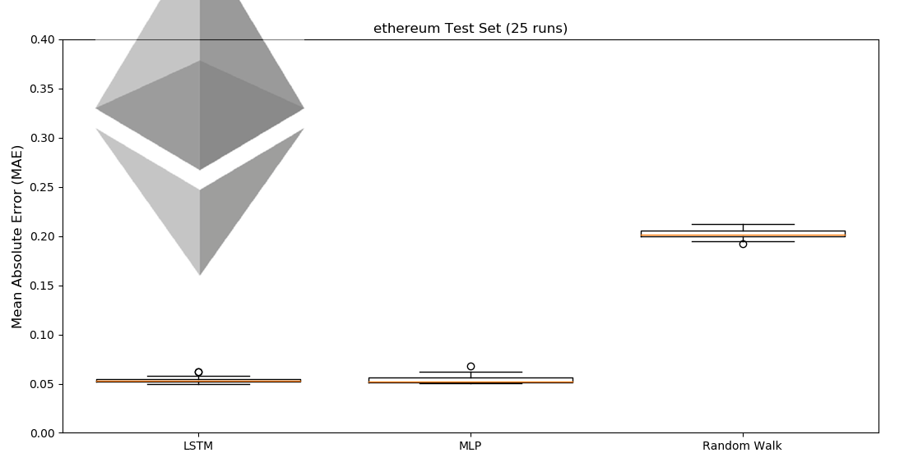
Results: Training set prediction

Slide 19
Conclusion
We successfully predicted the prices for the future with the help of the three methods that we used.
The LSTM model performs better than the usual MLP model while predicting the prices as seen from the 25 test runs performed with different random seeds.
The use of RNN with LSTM as the building blocks allows us to reduce the error even when the data trend shifts drastically as time progresses. It also reduces the effect that random seed has on the predictions.

Slide 20
Conclusion: Future scope
The model as of now focuses on using the Mean Absolute Error for the training purposes. We can improve the performance by including the Mean Squared Error while training the model.
Inclusion of Mean Squared Error is expected to make the model adjust better to the peaks and troughs there by improving the accuracy of predictions.
Using sentiment analysis might make the model efficient enough to predict the sudden rise/fall in the price. However it still doesn’t ensure that the model will be able to foresee the sudden movements.
Gathering more data in order to extract and utilize more features while training the model is another way to improve the accuracy of predictions.

Slide 21
References
1. A Machine Learning Approach for Stock Price Prediction
• Carson Kai-Sang Leung
• Richard Kyle MacKinnon
• Yang Wang
University of Manitoba, Winnipeg, MB, Canada
2. Short Term Stock Price Prediction Using Deep Learning (2017 2nd IEEE International Conference)
• Kaustubh Khare
• Omkar Darekar
• Prafull Gupta
• Dr. V. Z. Attar
College of Engineering, Pune, India

Slide 22
Thank you ☺
Have questions? Ask away!

